Slide 1


Final Presentation
Group : 3
Course Instructors:
Course Title: Artificial Intelligence Sessional
Course Code: CSE-404
Asst. Prof. Nusrat Sharmin
Asst. Prof. Md Akhtaruzzaman
Lec Raiyan Rahman

Slide 2

Group Members
NAME
ID
Chowdhury Farjana Tur Santona
202014010
Muhammad Samee Sevas
202014038
Shejuti Binte Feroz
202014050
Zakia Tamanna
202014061
Lt Shadman Shakib 201914070

Slide 3
অনুলিপি পরিচ্ছেদক: A Bangla Essay Plagiarism Detector

Slide 4
Idea Overview
The primary objective of our project is to develop a Bangla plagiarism detection tool for essays.
Input:
The model takes a Bangla essay as input, which can be either a direct entry or taken from the test file.
Output:
The output indicates whether the essay which is given as input is plagiarized or not plagiarized, providing a binary classification.

Slide 5
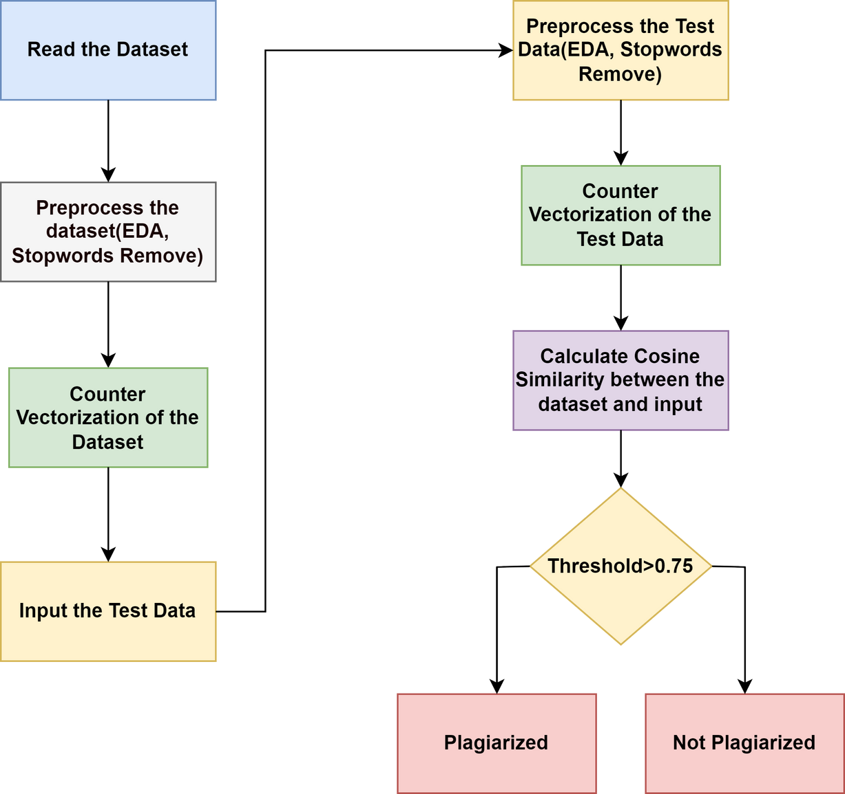
Architecture or Experimental Design
Figure 1: Workflow for Bangla Essay Plagiarism Detection

Slide 6
Dataset Overview
The datasets we have created are split into two datasets for analyzing plagiarism in Bangla essays.
The first dataset is stored in an Excel file called "bangla_essay_plagiarism_dataset," which consists of 181 sample original essays collected from 6-10 NCTB books and various online sources such as banglarachana.com, hazabarolo.com ,etc for training and analysis.
The second dataset is stored in an Excel file called "bangla_essay_plagiarism_test_dataset," containing 50 essays specifically designed by combining the most common essays in a plagiarized manner for testing the performance of plagiarism detection models.

Slide 7
Implementation and Demo

Slide 8
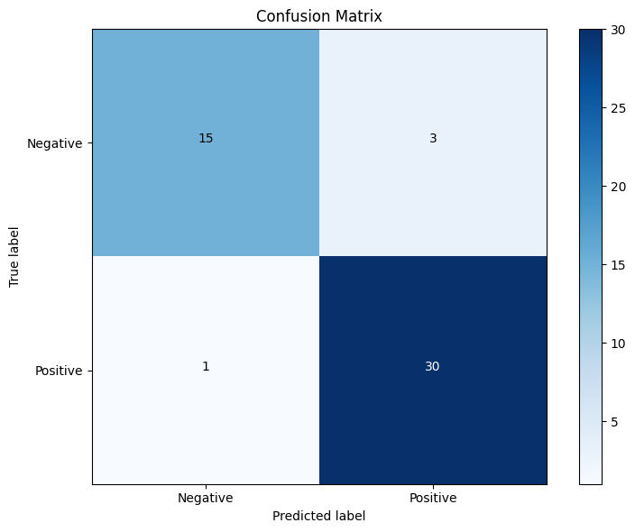
Evaluation
Confusion Matrix

Slide 9
Evaluation (Continued)
Performance Metrics
Accuracy = 91.83%
Precision = 90.90%
Recall = 96.77%
F1-Score = 93.75%

Slide 10

Discussion
Achievements:
Successfully developed a Bangla plagiarism detection tool that can effectively identify plagiarized content in Bangla essays.
Utilized pre-processing techniques and cosine similarity calculations to achieve efficient and reliable plagiarism detection.
Gained valuable insights and experience in Natural Language Processing (NLP) techniques, including text preprocessing, and similarity calculations.

Slide 11
Discussion
Further Potential Improvements:
Expanding the dataset
Incorporating advanced NLP techniques(ex : word2vec)
Exploring advanced deep learning architectures and optimization techniques

Slide 12
Idea for paper Publication
Implementing Word2vec to effectively handle paraphrased content
Utilizing deep learning techniques, to improve accuracy in detecting plagiarism in Bangla essays.

Slide 13
Thank You

